Slide 1
DIGITAL-TO-ANALOG CONVERSION
Digital-to-analog conversion is the process of changing one of the characteristics of an analog signal based on the information in digital data.
Topics discussed in this section:
Aspects of Digital-to-Analog Conversion Amplitude Shift Keying Frequency Shift Keying
Phase Shift Keying

Slide 2
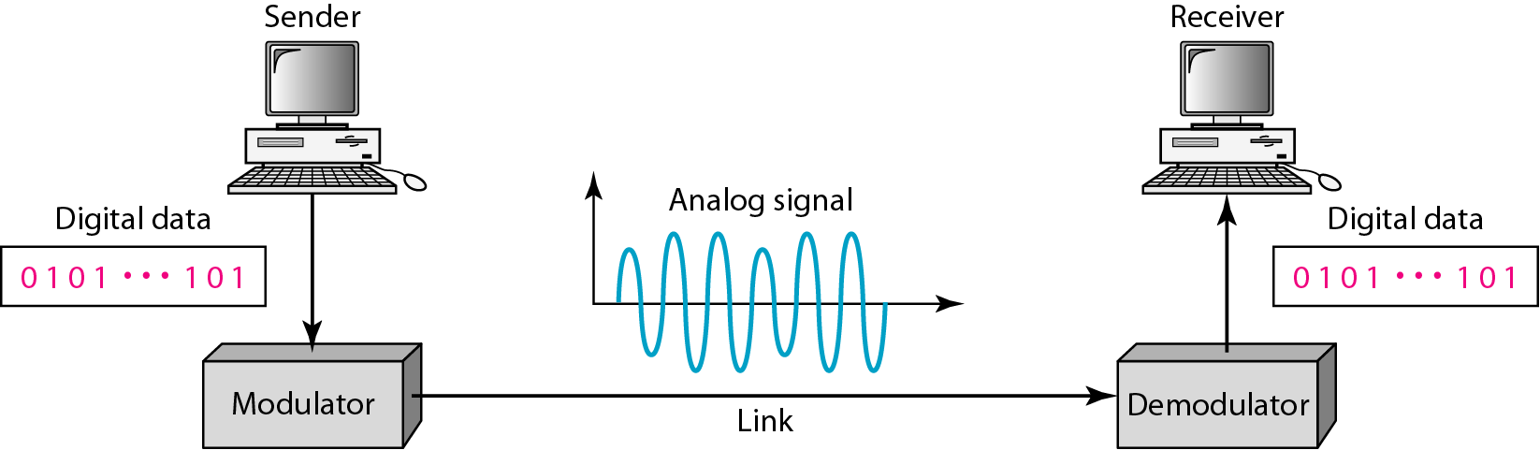
Figure 5.1 Digital-to-analog conversion

Slide 3
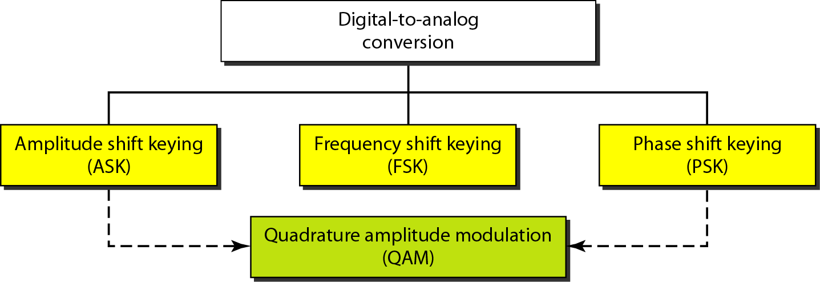
Figure 5.2 Types of digital-to-analog conversion

Slide 4

Note
Bit rate is the number of bits per second. Baud rate is the number of signal
elements per second.
In the analog transmission of digital data, the baud rate is less than or equal to the bit rate.

Slide 5
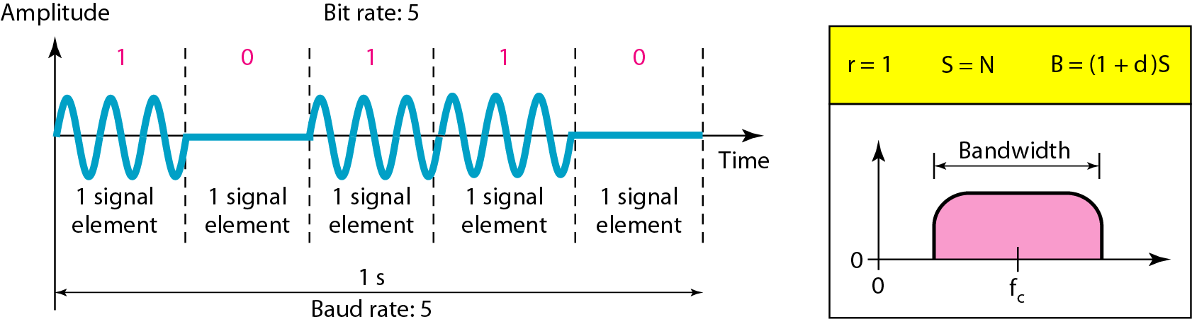
Figure 5.3 Binary amplitude shift keying

Slide 6
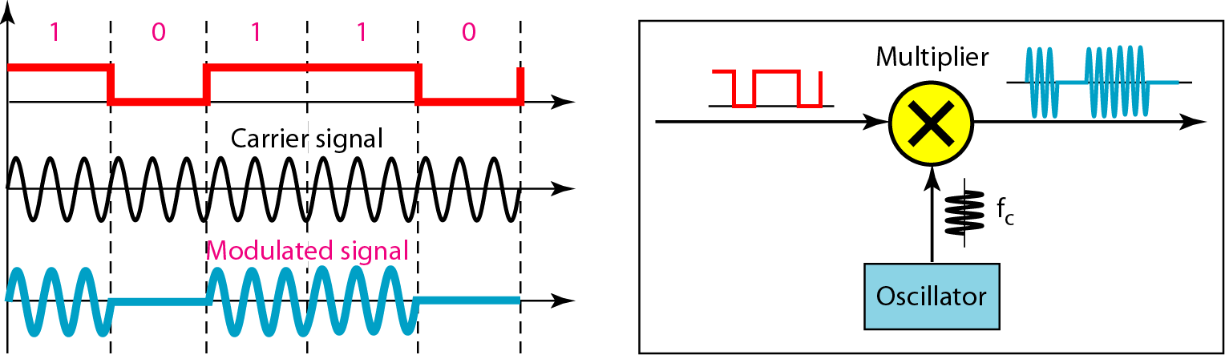
Figure 5.4 Implementation of binary ASK

Slide 7
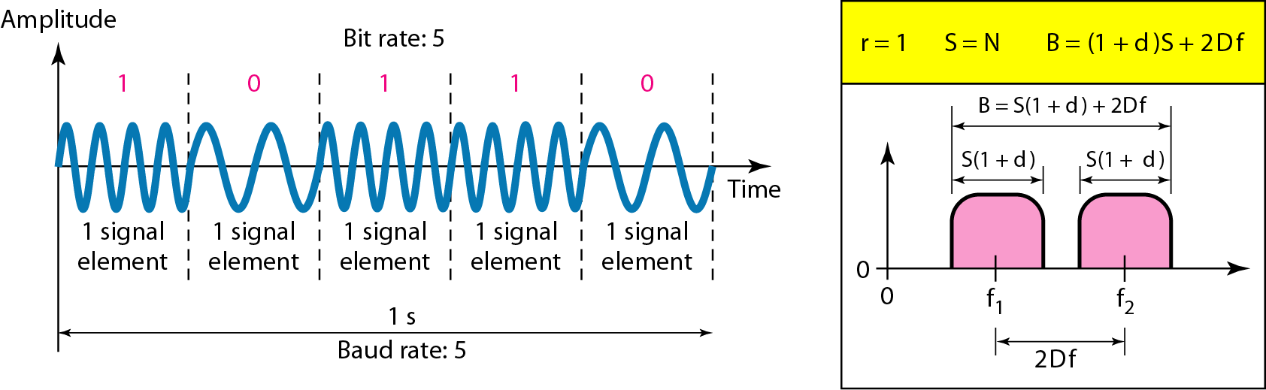
Figure 5.6 Binary frequency shift keying

Slide 8
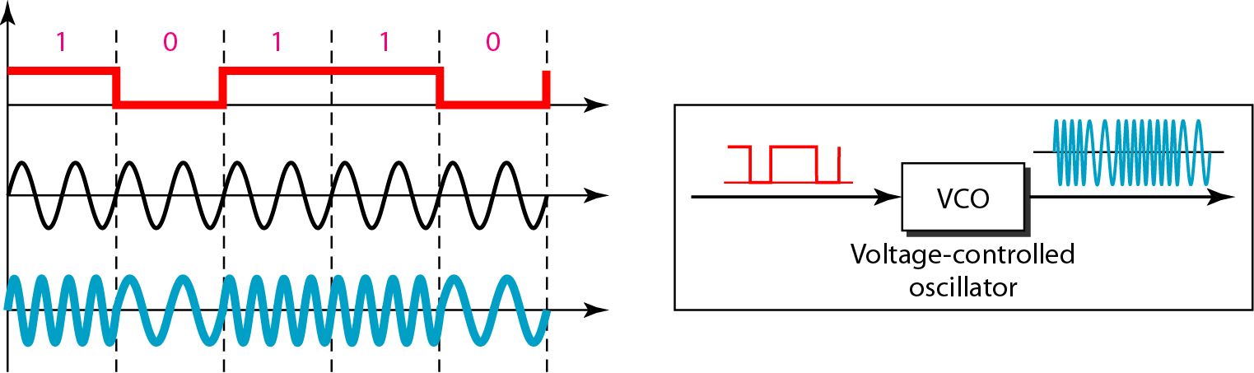
Figure 5.7 Bandwidth of MFSK used in Example 5.6

Slide 9
5-2 ANALOG AND DIGITAL
Analog-to-analog conversion is the representation of analog information by an analog signal. One may ask why we need to modulate an analog signal; it is already analog. Modulation is needed if the medium is bandpass in nature or if only a bandpass channel is available to us.
Topics discussed in this section:
Amplitude Modulation Frequency Modulation Phase Modulation

Slide 10
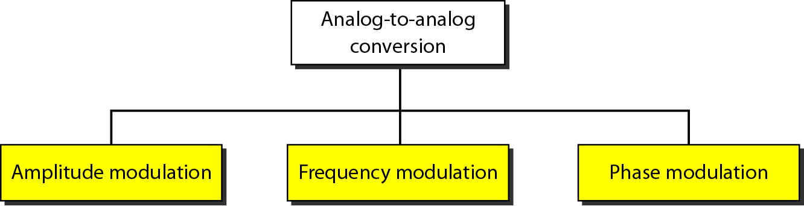
Figure 5.15 Types of analog-to-analog modulation

Slide 11
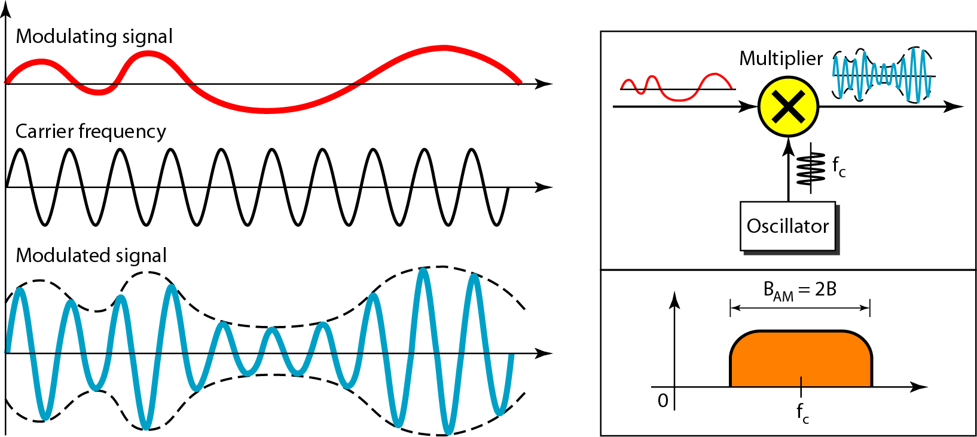
Figure 5.16 Amplitude modulation

Slide 12
Note
The total bandwidth required for AM can be determined
from the bandwidth of the audio signal: B_{AM} = 2B.

Slide 13
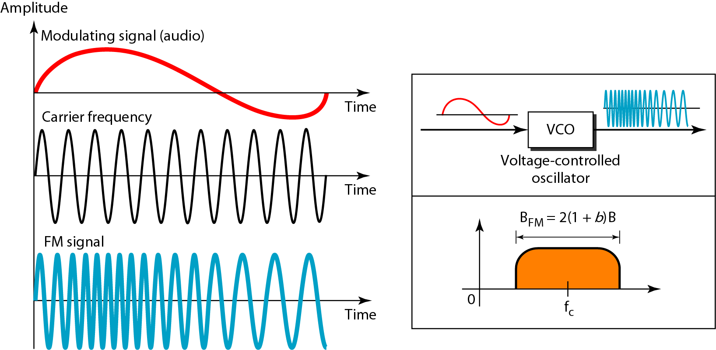
Figure 5.18 Frequency modulation

Slide 14
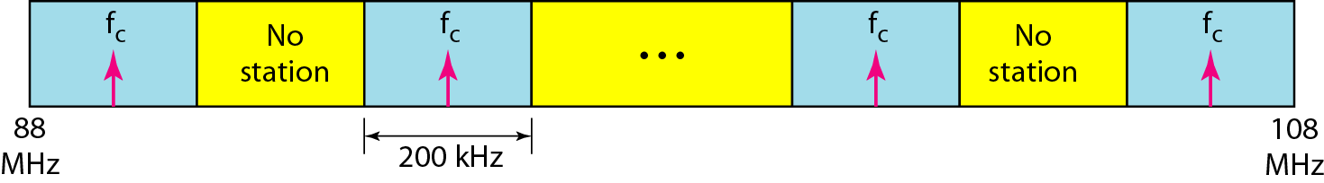
Figure 5.19 FM band allocation

Slide 15
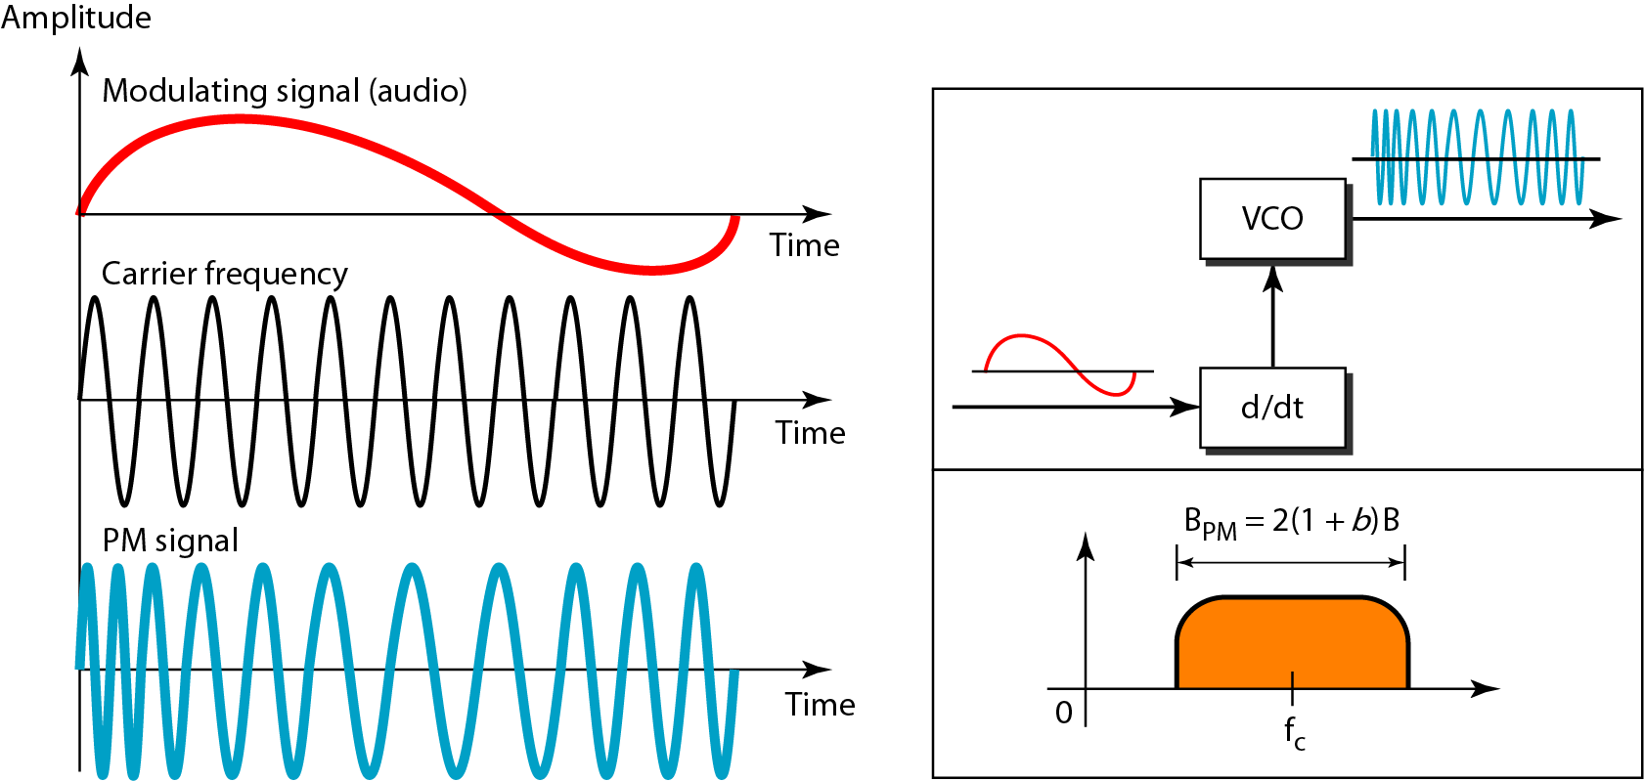
Figure 5.20 Phase modulation

Slide 16

References
Chapter 5
Analog Transmission
Copyright © The McGraw-Hill Companies, Inc. Permission required for reproduction or display.

